Slide 1

MACHINE LEARNING PROJECT INSIGHTS By Bhanu Aggarwal

Slide 2
Canopy Vision Phone Kart Cardio Divination Zoo Sorter

Slide 3
Submitted By: Bhanu Aggarwal UNID: UMID23052538378 Machine Learning Internship 25th May 2025 - 25th August 2025 Email: bhanuagg1183@gmail.com Mob: +91 94683-42280

Slide 4
Canopy Vision Project Insights

Slide 5
The aim of this project is to build a machine learning model capable of predicting the type of forest cover for a 30m x 30m patch of land in the Roosevelt National Forest of northern Colorado. By analyzing topographic and soil-related features, the project aims to assign each land patch to one of several forest cover categories. This predictive system can assist forest management authorities, conservationists, and researchers in identifying vegetation distribution patterns, monitoring ecological changes, and optimizing land management strategies.
OBJECTIVE

Slide 6
Spruce/Fir Lodgepole Pine Ponderosa Pine Cottonwood/Willow Aspen Douglas-fir Krummholz
DATASET TARGET VARIABLES

Slide 7
➢ Elevation is the most influential continuous variable, strongly correlated with cover type. Soil type indicators provide important categorical distinctions across forest categories. Other continuous variables such as slope, aspect, and hydrological distances capture micro-environmental conditions. Group-wise analysis indicates that certain cover types dominate specific regions, highlighting natural class imbalance. The dataset is well-structured, with no missing values, making it suitable for direct machine learning applications.
DATASET ANALYSIS

Slide 8
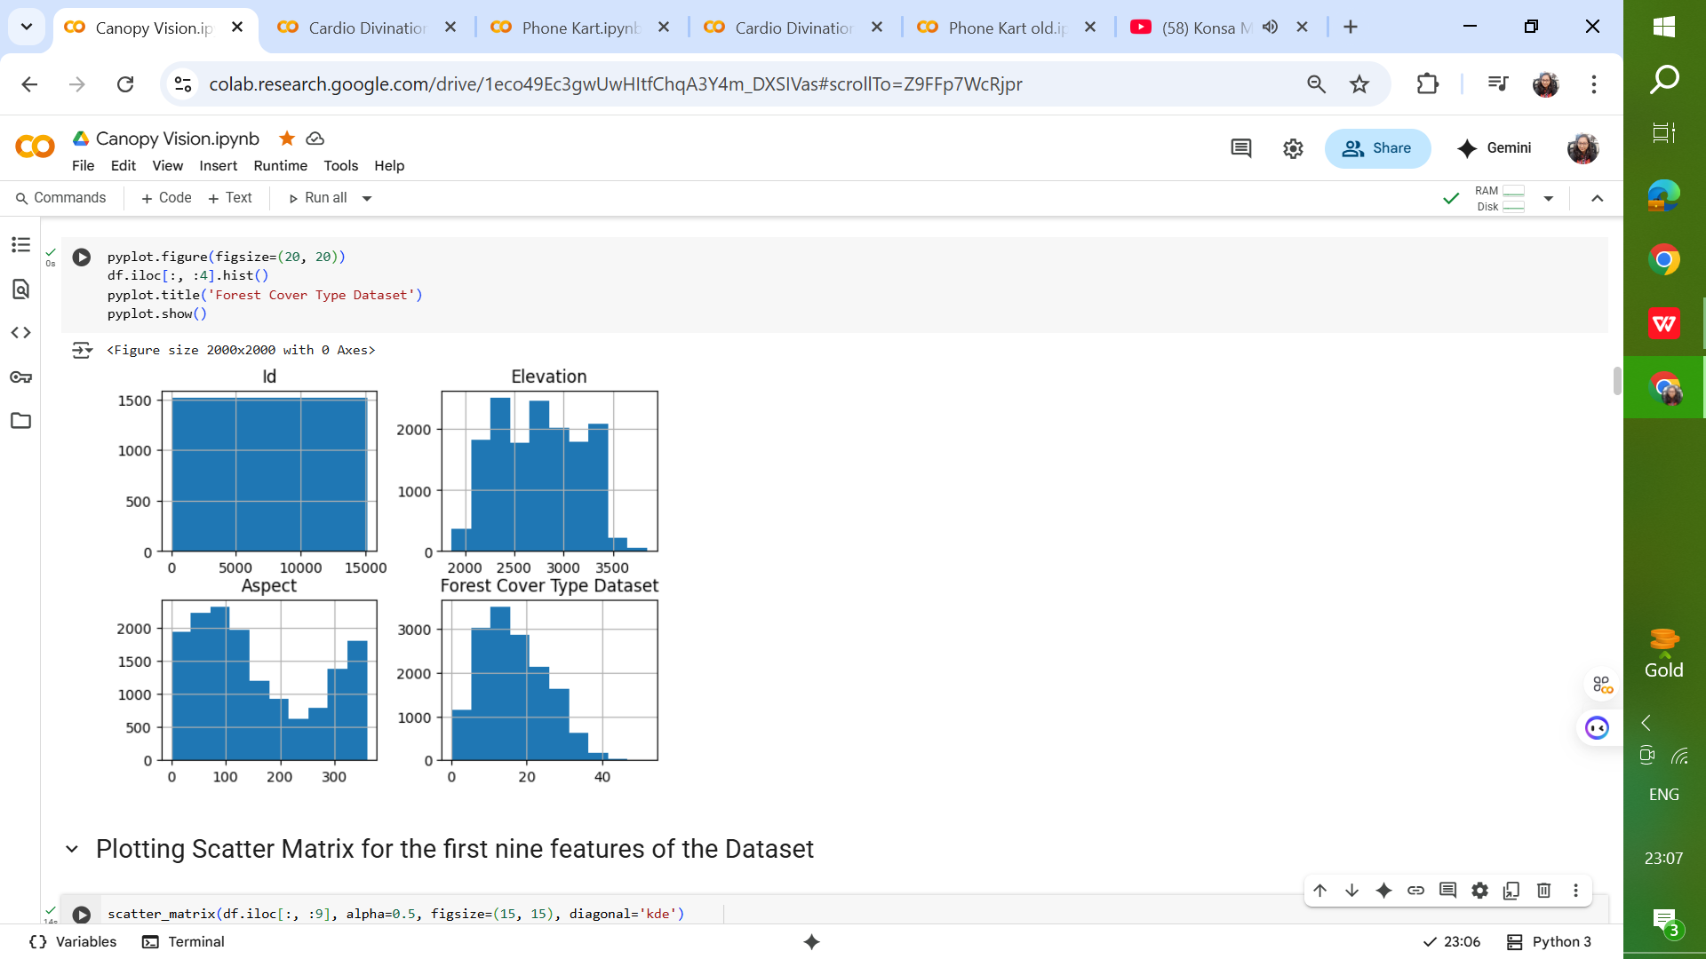
DATASET HISTOGRAMS

Slide 9
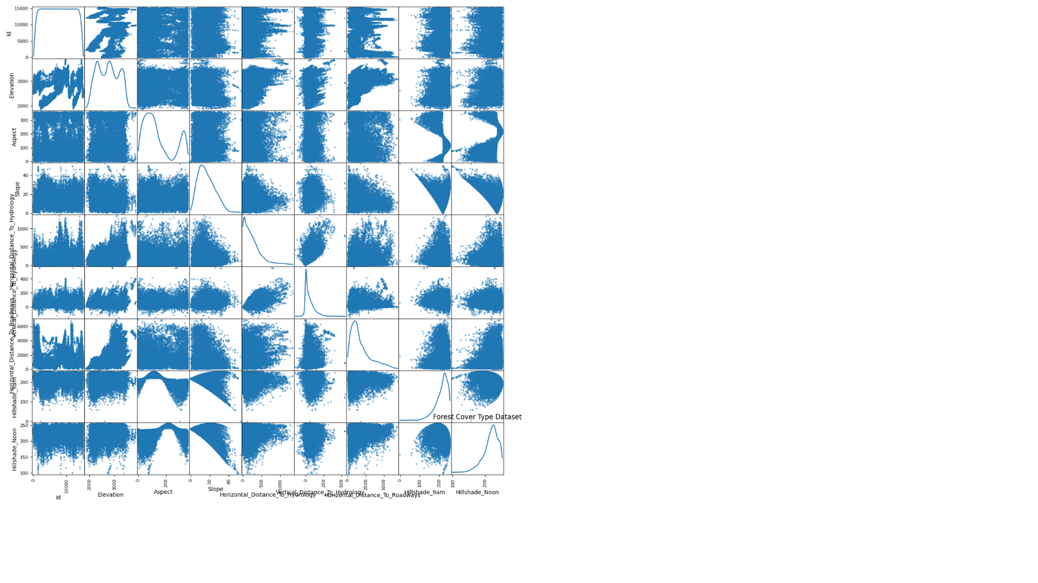
DATASET SCATTER MATRICES

Slide 10
Logistic Regression: 65–70% accuracy  Random Forest Classifier: 85–90% accuracy  Linear Discriminant Analysis: 60–65% accuracy  K-Neighbors Classifier: 75–80% accuracy  Decision Tree Classifier: 75–80% accuracy  Gaussian NB: 55–60% accuracy  SVM: 15–20% accuracy
MODEL ACCURACY

Slide 11
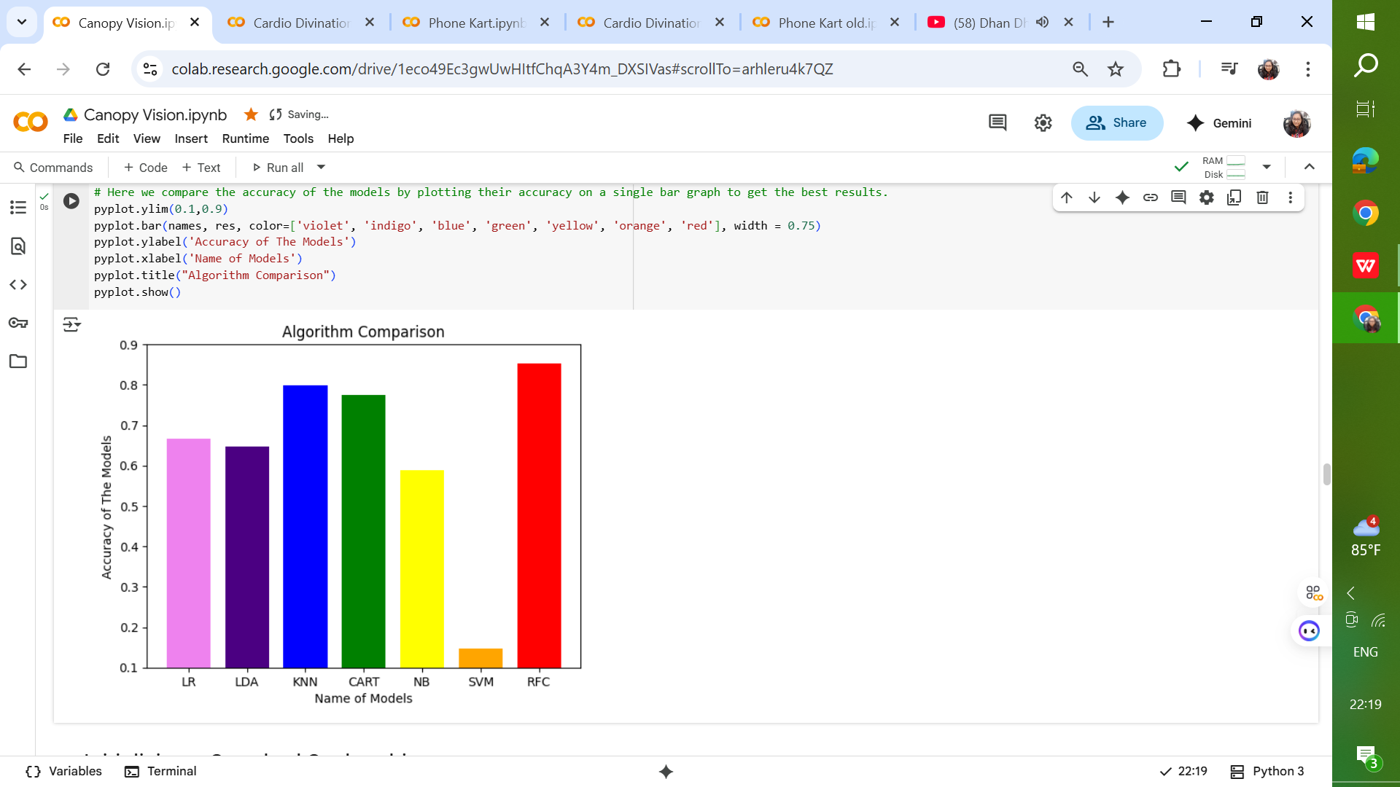
MODEL ACCURACY

Slide 12
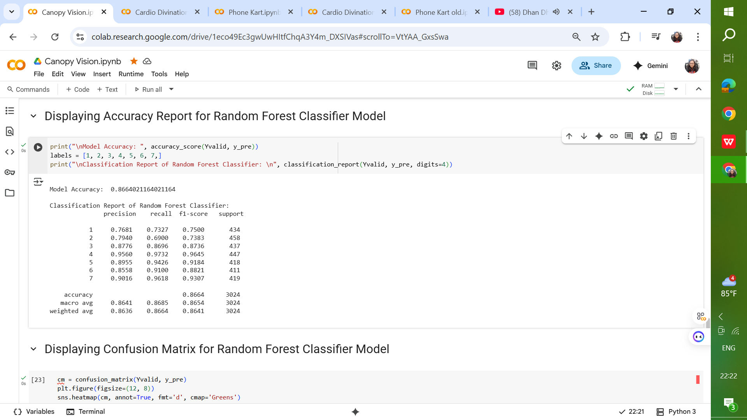
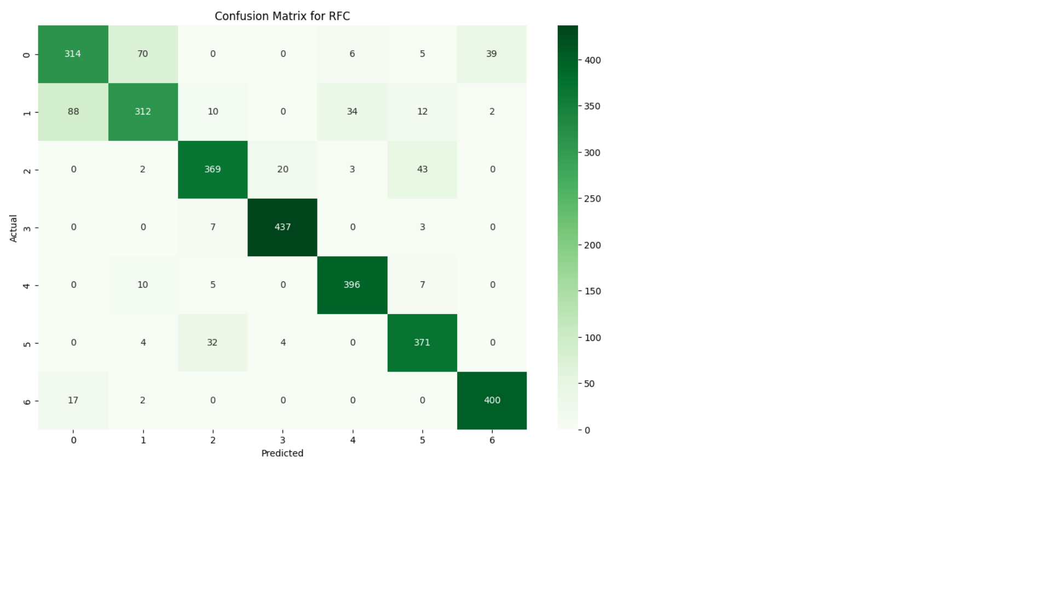
MODEL ACCURACY

Slide 13
Elevation emerged as the most significant predictor. Soil type and distance to hydrology were also highly influential.
FEATURE IMPORTANCE

Slide 14
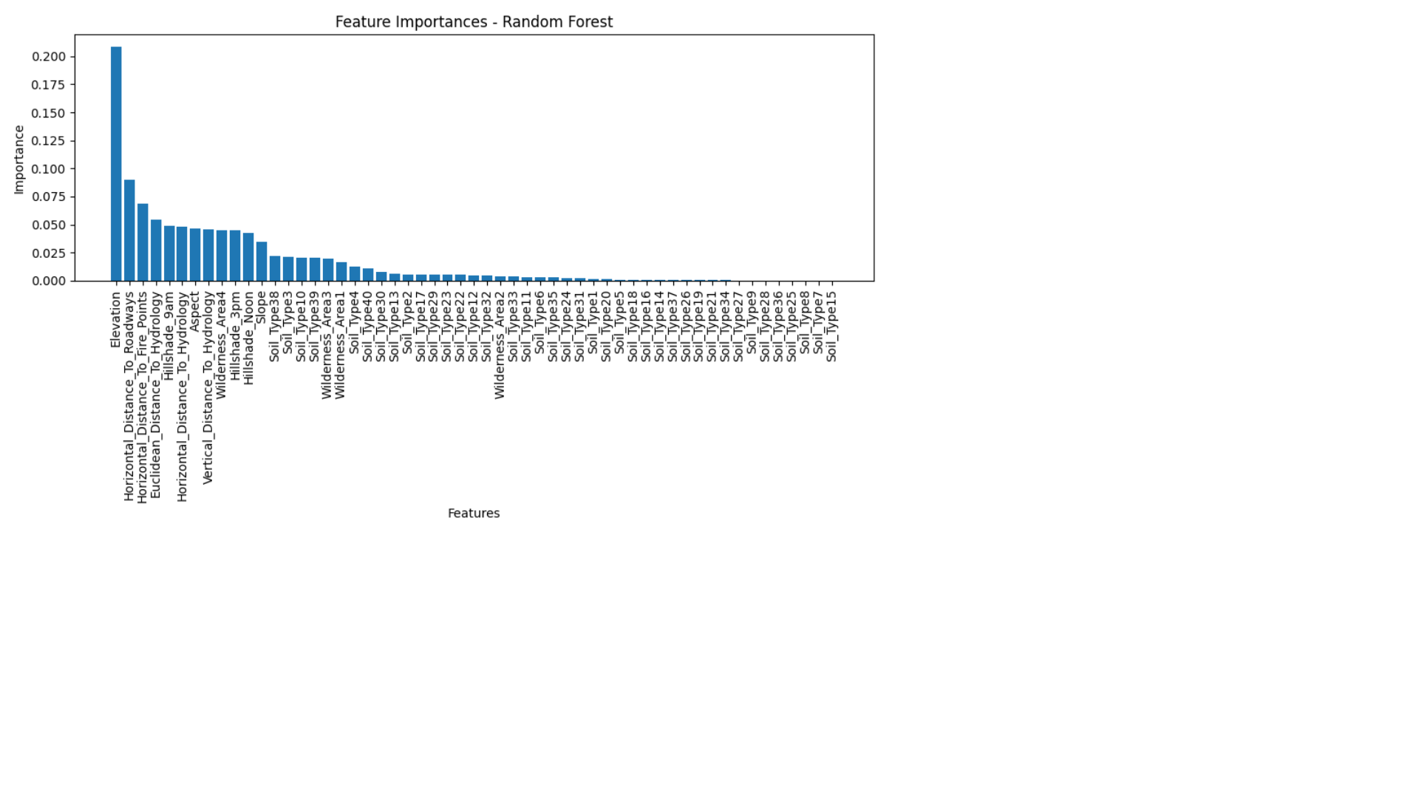
FEATURE IMPORTANCE

Slide 15
Elevation is consistently the most significant predictor across models. For example, Spruce/Fir dominates higher elevations, while Ponderosa Pine occurs at mid-elevations. Soil types and wilderness area features influences the presence of certain species and adds important categorical signals to differentiate forest types (e.g., Aspen thrives on specific soils). Class imbalance poses challenges for minority forest types, making precision and recall crucial metrics beyond accuracy. Ensemble models outperform linear models by capturing complex, non-linear relationships in the dataset.
OBSERVATION

Slide 16
Applying Deep Learning for complex feature interactions. Performing Hyperparameter Optimization. Incorporating spatial/geographic data (e.g., satellite imagery). Deploying the model as an API for forest management systems. Using SMOTE or class-weight balancing to address class imbalance.
FUTURE SCOPE

Slide 17
Phone Kart Project Insights

Slide 18
➢ The Phone Kart project is designed to develop a machine learning-based predictive system capable of classifying mobile phones into specific price categories based on their technical specifications. The primary aim is to assist online marketplaces, retailers, and customers in estimating the appropriate price range for a given phone configuration.
OBJECTIVE

Slide 19
Low Price Medium Price High Price Very High Price
DATASET TARGET VARIABLES

Slide 20
Battery Power (mAh) Bluetooth Support (binary: 1/0) Clock Speed (GHz) Dual SIM Support Front Camera Resolution (megapixels) 4G Support (binary: 1/0) Internal Memory (GB) RAM (MB) Talk Time (hours) Touch Screen Availability WiFi Support
DATASET ANALYSIS

Slide 21
Random Forest Classifier - 89% Gradient Boosting Classifier - 91% Linear Regression Classifier - 91%
MODEL ACCURACY

Slide 22
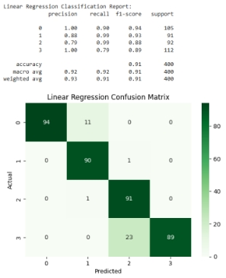
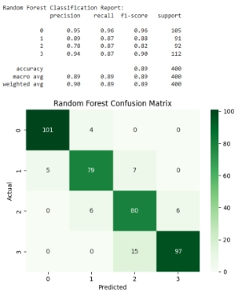
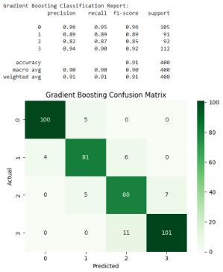
MODEL ACCURACY

Slide 23
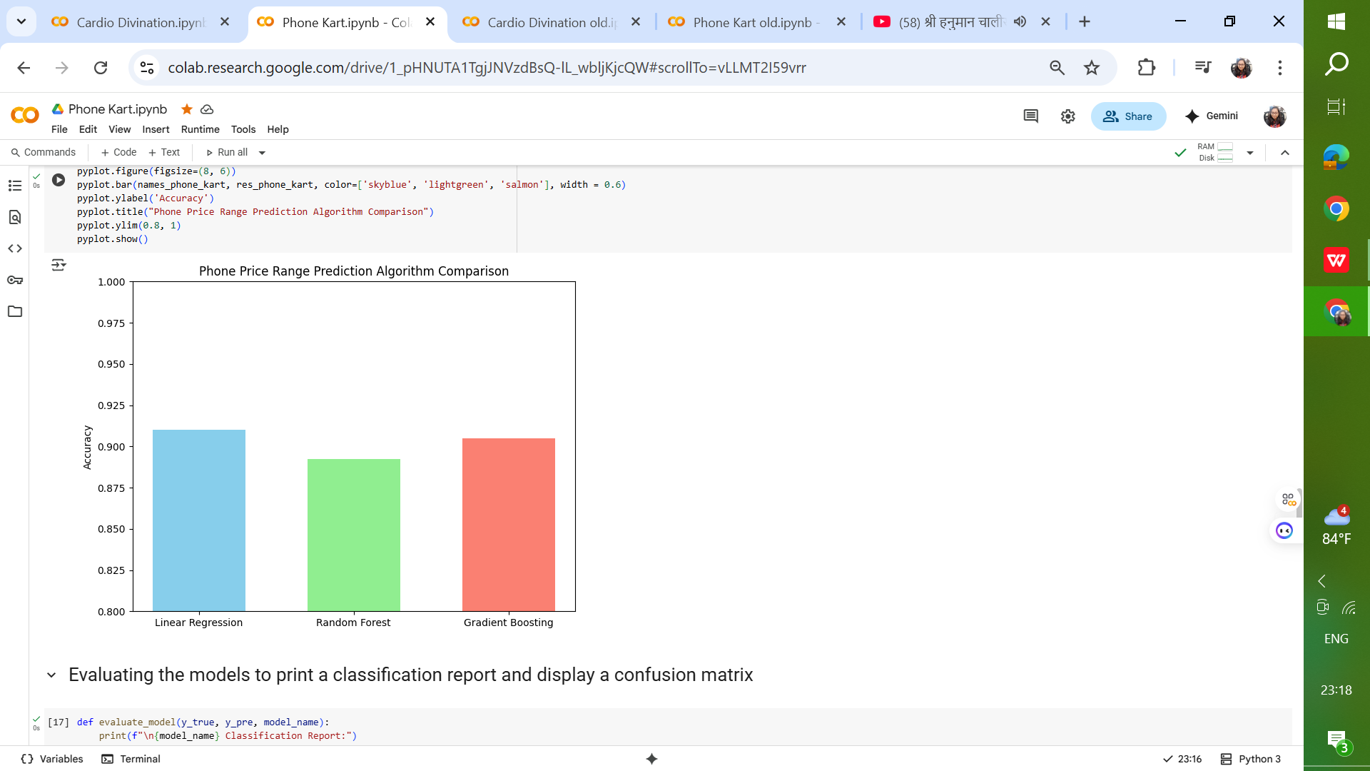
MODEL ACCURACY

Slide 24
Linear Regression provided only moderate accuracy due to its assumption of linear relationships. Random Forest achieved high accuracy, effectively handling non-linear patterns. Gradient Boosting outperformed all models by optimizing errors iteratively. Feature importance analysis highlighted that RAM, battery power, and processor speed are the most influential factors in predicting a phone’s price category.
MODEL INSIGHTS

Slide 25
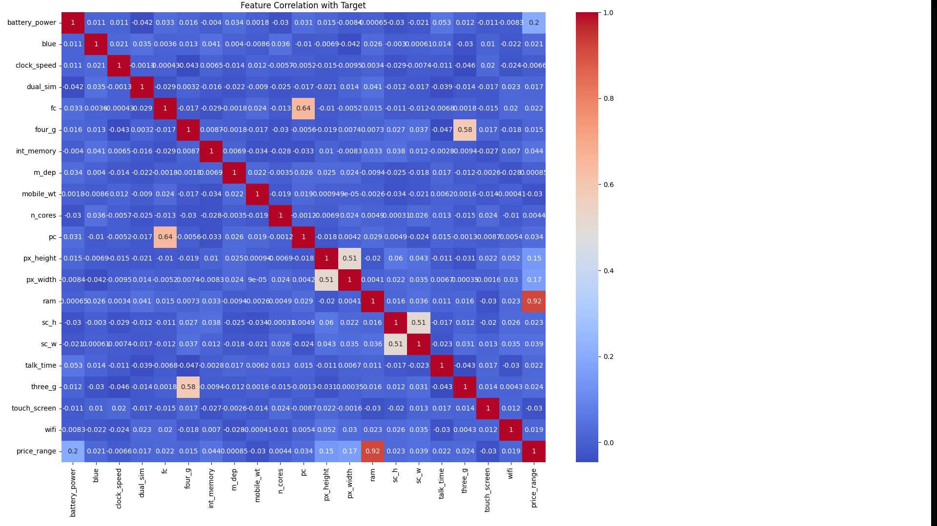
FEATURE IMPORTANCE

Slide 26
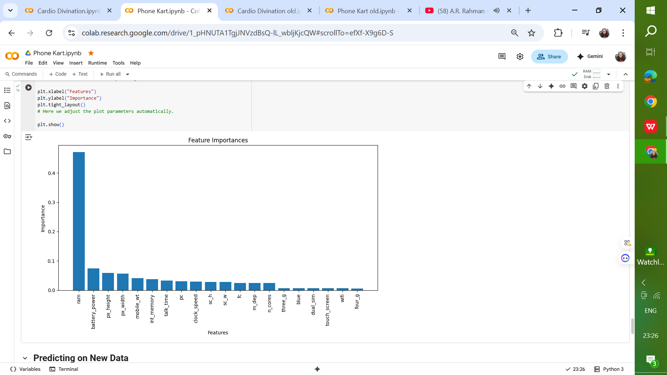
FEATURE IMPORTANCE

Slide 27
Ensemble methods like Random Forest and Gradient Boosting are better suited for categorical price prediction than simple regression models. Linear Regression – Used as a baseline regression model to predict price categories. Random Forest Classifier – A robust ensemble learning method using bagging of decision trees. Gradient Boosting Classifier – A boosting approach that sequentially builds strong learners. Feature scaling improves the performance of models sensitive to feature magnitude. RAM size is consistently the top predictor of a mobile’s price category.
OBSERVATION

Slide 28
Adding more high-level features such as brand, release year, and operating system. Using deep learning approaches for feature extraction and classification. Deploying the model as an API for integration with e-commerce platforms. Performing hyperparameter optimization for all models to further improve accuracy.
FUTURE SCOPE

Slide 29
Cardio Divination Project Insights

Slide 30
The Cardio Divination project aims to develop a predictive machine learning model for detecting the likelihood of heart disease in patients based on a set of clinical and demographic features. The primary goal is to aid healthcare professionals in early diagnosis and prevention by providing a reliable decision-support tool. The project focuses on leveraging Support Vector Machine (SVM) classification to achieve high accuracy in distinguishing between patients with and without heart disease.
OBJECTIVE

Slide 31
Heart Disease No Heart Disease
DATASET TARGET VARIABLES

Slide 32
Age: Age of the patient in years Sex: 1 for male, 0 for female Chest Pain Type: Encoded as integers (0–3) representing different categories Resting Blood Pressure: Measured in mm Hg Serum Cholesterol: Measured in mg/dl Fasting Blood Sugar: 1 if > 120 mg/dl, else 0 Resting ECG: Encoded ECG results (0–2) Max Heart Rate Achieved: Known as thalach Exercise-Induced Angina: 1 for yes, 0 for no Oldpeak: ST depression induced by exercise ST Slope: Encoded categorical feature
DATASET ANALYSIS

Slide 33
High classification accuracy on unseen patient data. Balanced precision and recall, indicating reliability for both positive and negative cases. The RBF kernel demonstrated the best trade-off between complexity and accuracy.
MODEL INSIGHTS

Slide 34
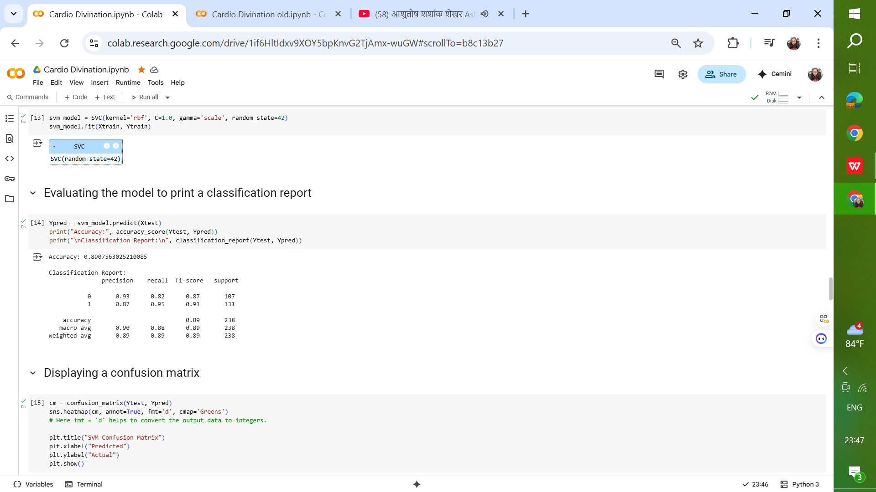
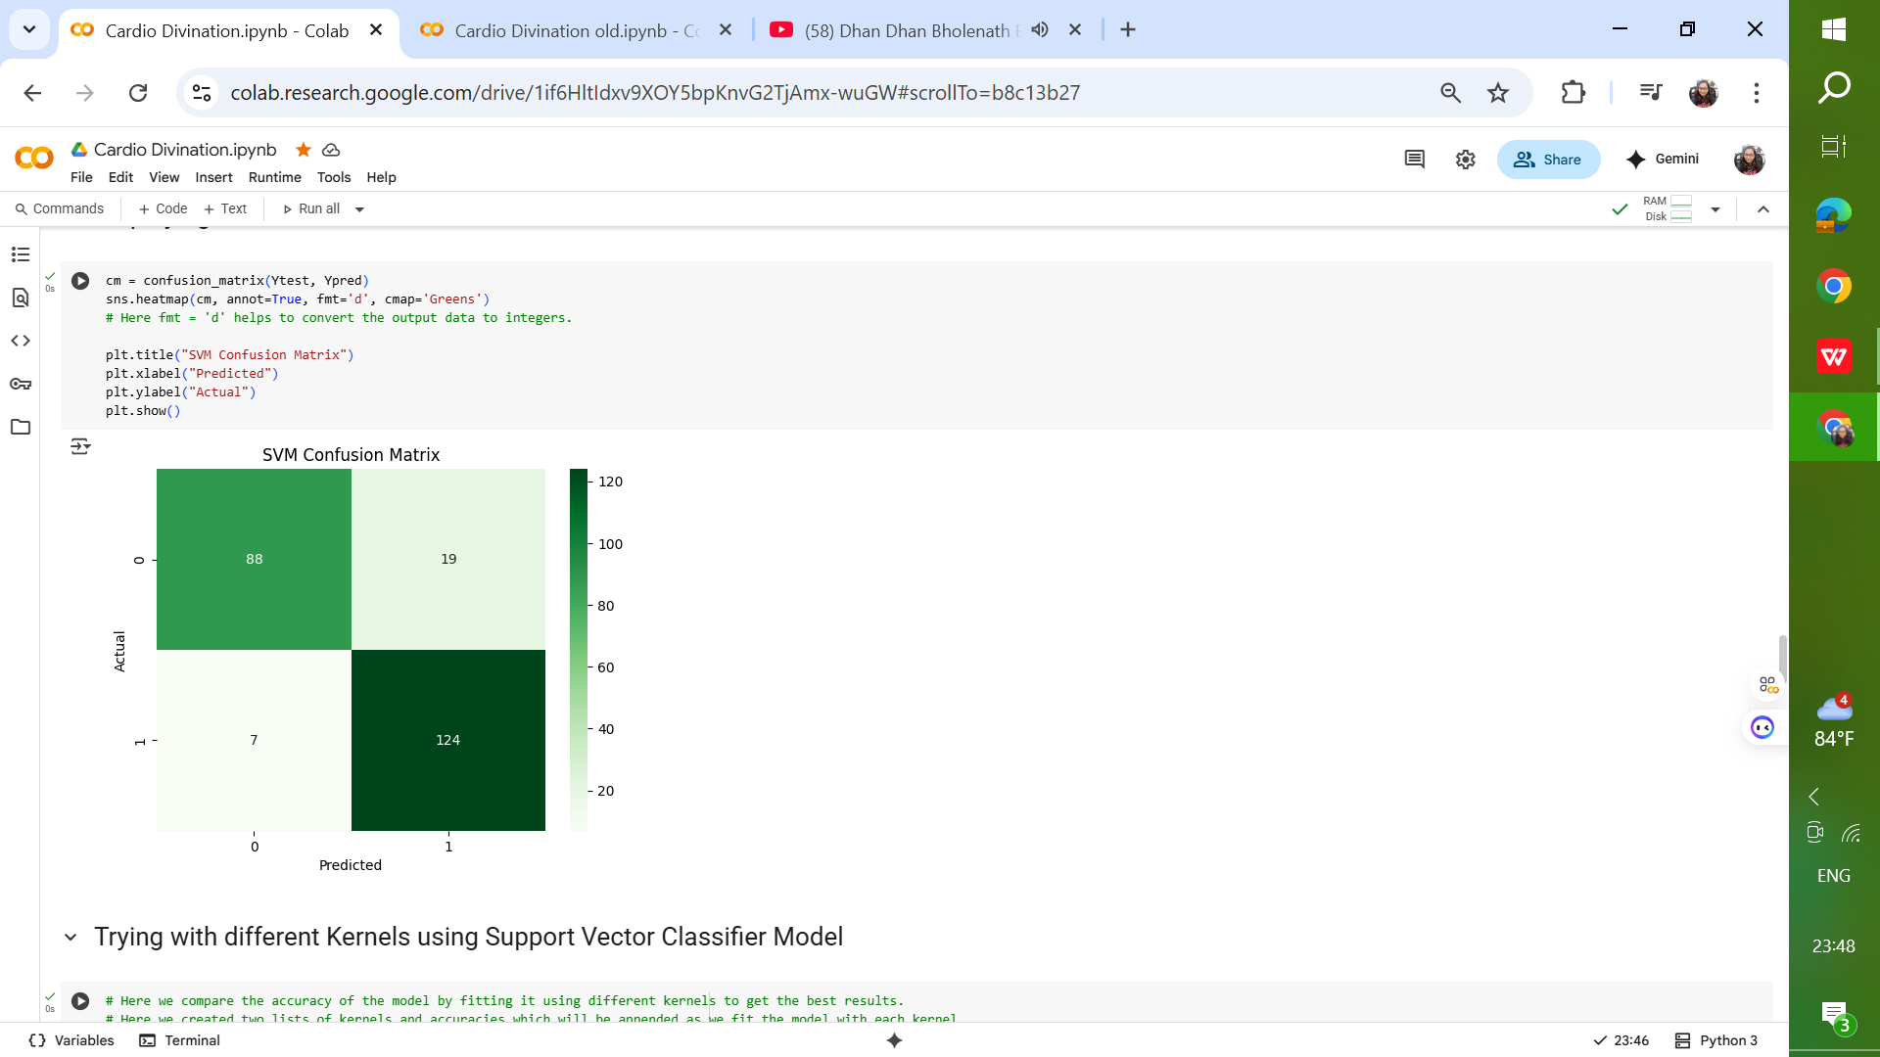
MODEL ACCURACY

Slide 35
Confusion matrix analysis revealed that most misclassifications occurred in borderline cases with overlapping feature values between classes. The Support Vector Machine classifier was chosen for its ability to handle high-dimensional data and find optimal separating hyperplanes between classes. The model was initially trained with the default kernel (linear) and later experimented with different kernels such as polynomial and radial basis function (RBF) to explore potential performance improvements. Hyperparameters such as C and gamma were tuned during experimentation to optimize model accuracy.
MODEL INSIGHTS

Slide 36

MODEL ACCURACY

Slide 37
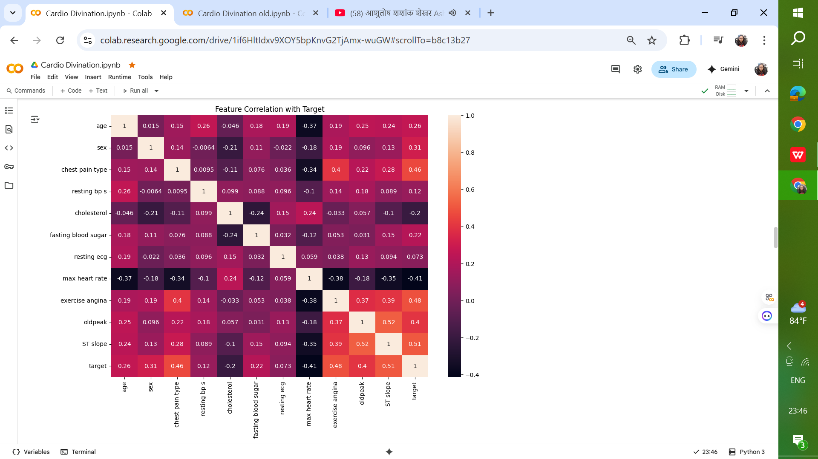
FEATURE IMPORTANCE

Slide 38
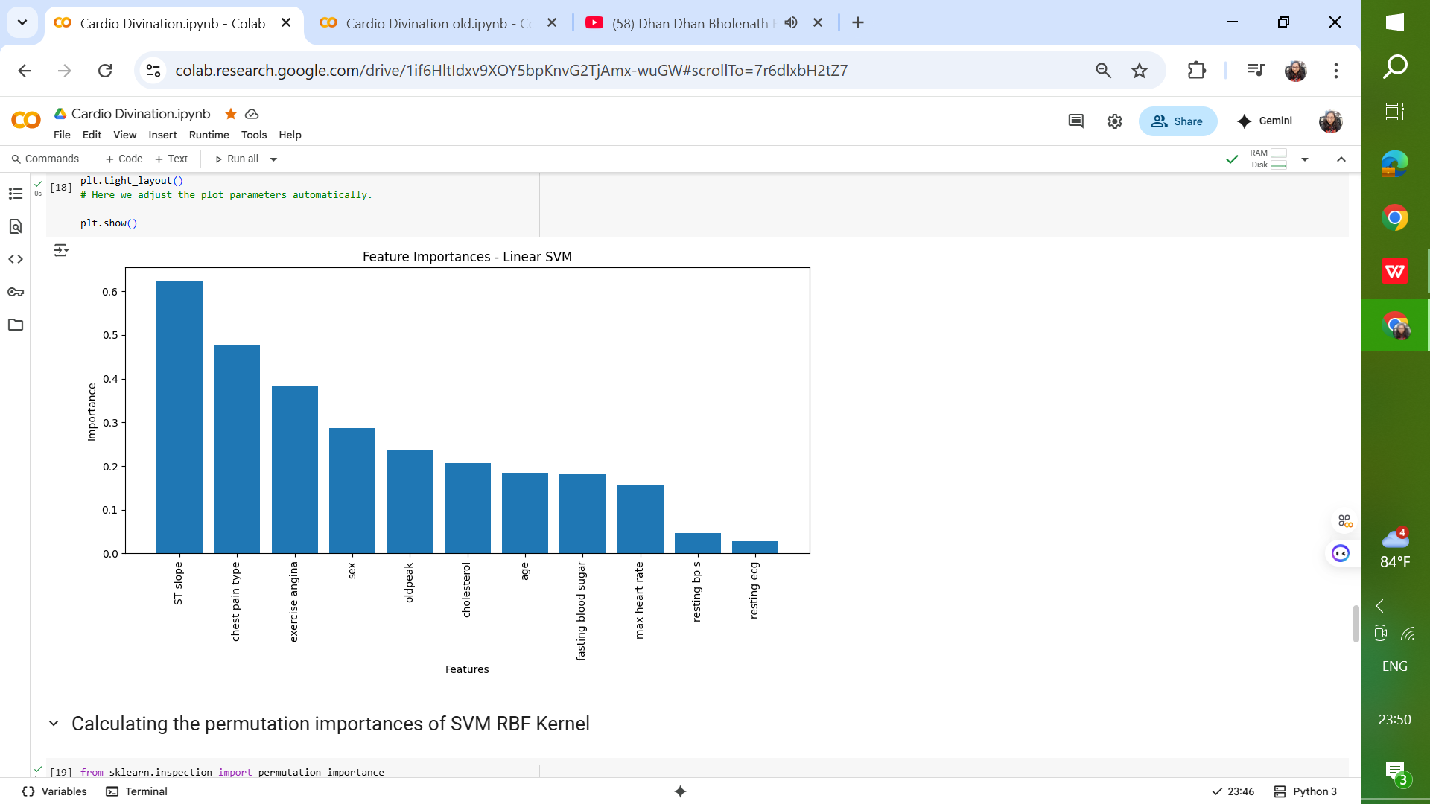
FEATURE IMPORTANCE

Slide 39
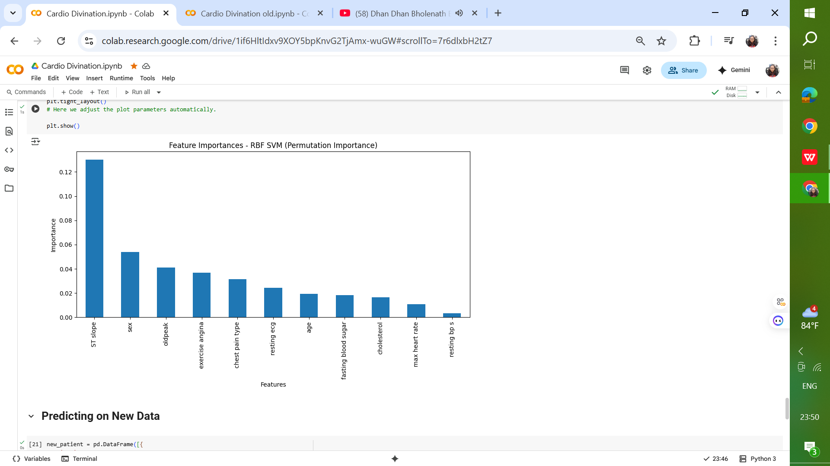
FEATURE IMPORTANCE

Slide 40
Patients with higher age, cholesterol levels, and resting BP, combined with lower max heart rate and presence of exercise-induced angina, were more likely to be classified as having heart disease. Feature scaling significantly impacted the performance of the SVM model. Kernel selection plays a critical role in capturing non-linear patterns in the dataset. Support Vector Machines are powerful and flexible, capable of handling complex boundaries and high-dimensional data. SVM are best suited when accuracy is critical and dataset size is moderate, but can become computationally heavy for very large datasets.
OBSERVATION

Slide 41
Incorporate additional patient data to improve model generalization. Apply advanced feature selection or dimensionality reduction techniques such as PCA. Experiment with ensemble models combining SVM with tree-based algorithms. Deploy the model in a web-based application for real-time risk assessment.
FUTURE SCOPE

Slide 42
Zoo Sorter Project Insights

Slide 43
The primary objective of this project is to design, implement, and evaluate an advanced image classification system capable of accurately identifying animals from a given image. The project leverages deep learning techniques, particularly Convolutional Neural Networks (CNNs), to perform multi-class classification across 15 predefined animal categories. This project addresses real-world applications such as wildlife monitoring, biodiversity research, zoological management, and educational tools. By accurately identifying animals from images, the system can assist in automating tasks that would otherwise require manual visual inspection.
OBJECTIVE

Slide 44
Bear Bird Cat Cow Deer
DATASET TARGET VARIABLES
Dog
Dolphin Elephant Giraffe Horse
Kangaroo Lion Panda Tiger Zebra

Slide 45
Training Set (70%): Used for model learning. Validation Set (15%): Used to monitor performance during training and tune hyperparameters. Test Set (15%): Used for final evaluation to measure the generalization capability of the model.
DATASET ANALYSIS

Slide 46
DATASET AUGMENTATION FEATURES
Random rotations
Horizontal and vertical flips
Random zooming and shifting
Brightness and contrast adjustments

Slide 47
MODEL ARCHITECTURE
Input Layer
Base Model (Pre-trained CNN)
Global Average Pooling (GAP) Layer
Dense (Fully Connected) Layers
Output Layer


Slide 48
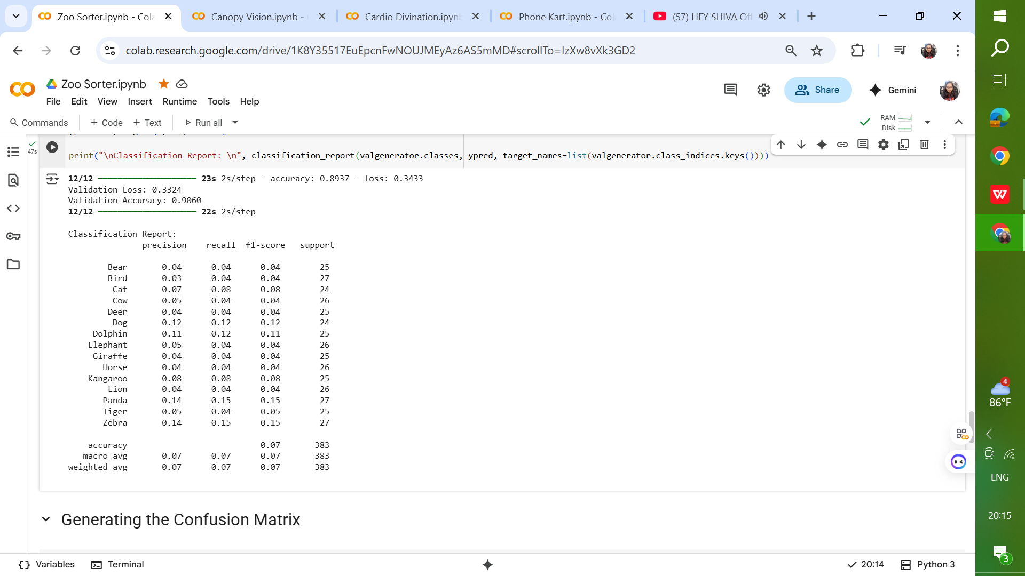
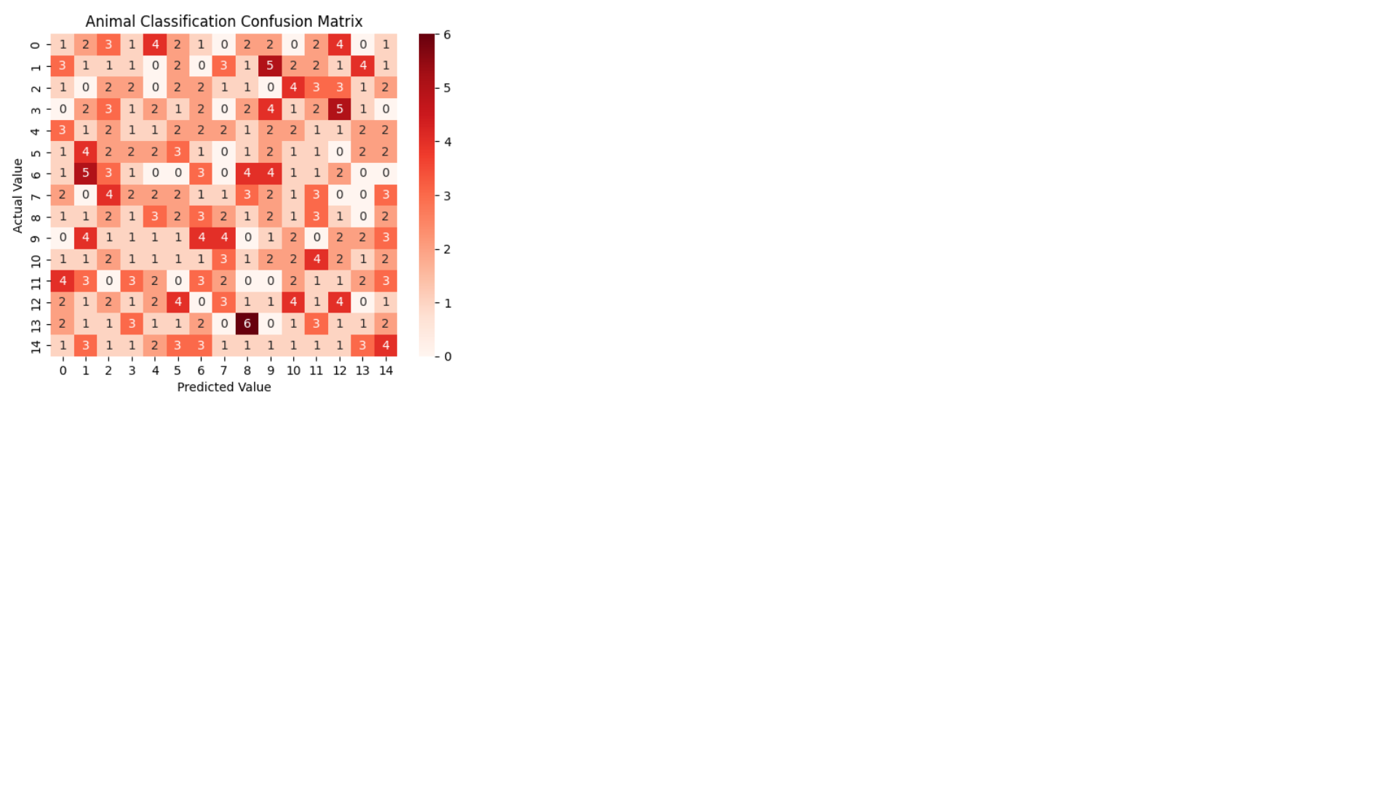
MODEL ACCURACY

Slide 49
Training Accuracy: High accuracy with minimal overfitting. Validation Accuracy: Consistent with training accuracy, indicating good generalization. Test Accuracy: High performance on unseen data, demonstrating the effectiveness of the architecture.
MODEL ACCURACY

Slide 50

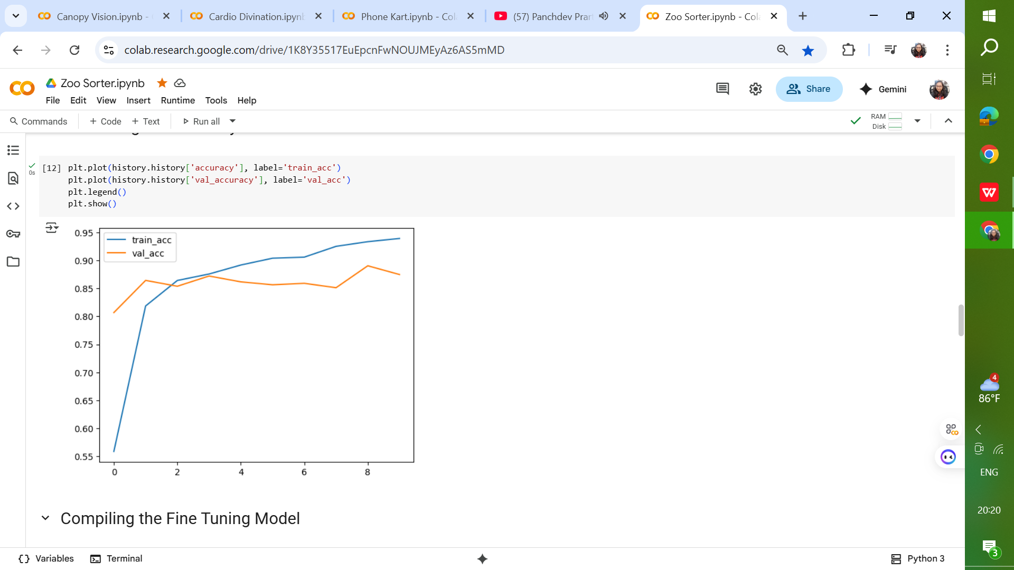
MODEL ACCURACY

Slide 51
Transfer learning significantly accelerated training and improved accuracy. Data augmentation played a crucial role in boosting model robustness. Misclassifications often occurred between visually similar species. The model showed resilience to variations in lighting and image background. Ensemble methods could further improve classification accuracy.
OBSERVATION

Slide 52
This architecture follows the transfer learning paradigm: Pre-trained CNN → feature extractor GAP & Dense Layers → compact representation and decision-making Softmax Output → final multi-class classification It strikes a balance between efficiency, generalization, and accuracy, making it suitable for image classification tasks on moderately sized datasets.
OBSERVATION

Slide 53
Expanding the dataset with more diverse images. Incorporating ensemble deep learning architectures. Deploying as a cloud-based API for real-time animal recognition. Integrating object detection to identify multiple animals in single image. Utilizing attention mechanisms to focus on key image regions.
FUTURE SCOPE

Slide 54
Submitted By: Bhanu Aggarwal UNID: UMID23052538378 Machine Learning Internship 25th May 2025 - 25th August 2025 Email: bhanuagg1183@gmail.com Mob: +91 94683-42280

Slide 55
THANK YOU

